Slide 1
VBScript
Session 17

Slide 2
What we learn last session?

Slide 3
Subjects for session 17
Class object.
Class statement.
  Property Let.
  Property Get.
  Property Set.
  Initialize event.
  Terminate event.
Inline classes.
Registering your COM classes.

Slide 4
Classes in VBScript
Class Object
The object created using the Class statement.
Provides access to the events of the class.
You cannot explicitly declare a variable to be of type Class.
In the VBScript context, the term "class object" refers to any object defined using the VBScript Class statement.
    Dim X
    Set X = New classname

Slide 5
Classes in VBScript
Class Statement
Declares the name of a class, as well as a definition of the variables, properties, and methods that comprise the class.
Syntax
      Class name
      statements
      End Class

Slide 6
Classes in VBScript
Class Statement
Within a Class block, members are declared as either Private or Public using the appropriate declaration statements.
Anything declared as Private is visible only within the Class block.
Anything declared as Public is visible within the Class block, as well as by code outside the Class block.
Anything not explicitly declared as either Private or Public is Public by default.
Procedures (either Sub or Function) declared Public within the class block become methods of the class.
Public variables serve as properties of the class, as do properties explicitly declared using Property Get, Property Let, and Property Set.
Default properties and methods for the class are specified in their declarations using the Default keyword.

Slide 7
Classes in VBScript
Get Property Statement
Declares, in a Class block, the name, arguments, and code that form the body of a Property procedure that gets (returns) the value of a property.
Syntax
  [Public [Default] | Private] Property Get name [(arglist)]
  [statements]
  [[Set] name = expression]
  [Exit Property]
  [statements]
  End Property

Slide 8
Classes in VBScript
Get Property Statement
If not explicitly specified using either Public or Private, Property Get procedures are public by default, that is, they are visible to all other procedures in your script.
The value of local variables in a Property Get procedure is not preserved between calls to the procedure.
You can't define a Property Get procedure inside any other procedure.
The Exit Property statement causes an immediate exit from a Property Get procedure.
Property Get procedure is a separate procedure that can take arguments, perform a series of statements, and change the value of its arguments.

Slide 9
Classes in VBScript
Let Property Statement
Declares, in a Class block, the name, arguments, and code that form the body of a Property procedure that assigns (sets) the value of a property.
Syntax
  [Public [Default] | Private] Property Let name ([arglist,] value)
  [statements]
  [[Set] name = expression]
  [Exit Property]
  [statements]
  End Property

Slide 10
Classes in VBScript
Let Property Statement
If not explicitly specified using either Public or Private, Property Let procedures are public by default, that is, they are visible to all other procedures in your script.
The value of local variables in a Property Let procedure is not preserved between calls to the procedure.
You can't define a Property Let procedure inside any other procedure.
The Exit Property statement causes an immediate exit from a Property Let procedure.
Every Property Let statement must define at least one argument for the procedure it defines.

Slide 11
Classes in VBScript
Set Property Statement
Declares, in a Class block, the name, arguments, and code that form the body of a Property procedure that sets a reference to an object.
Syntax
  [Public [Default] | Private] Property Set name ([arglist,] reference)
  [statements]
  [[Set] name = expression]
  [Exit Property]
  [statements]
  End Property

Slide 12
Classes in VBScript
Set Property Statement
If not explicitly specified using either Public or Private, Property Set procedures are public by default, that is, they are visible to all other procedures in your script.
The value of local variables in a Property Set procedure is not preserved between calls to the procedure.
You can't define a Property Set procedure inside any other
The Exit Property statement causes an immediate exit from a Property Set procedure.
Every Property Set statement must define at least one argument for the procedure it defines.

Slide 13
Classes in VBScript
Initialize Event
Occurs when an instance of the associated class is created.
Syntax
    Private Sub Class_Initialize()
    statements
    End Sub
  Set X = New TestClass ' Create an instance of TestClass.
  Set X = Nothing ' Destroy the instance.

Slide 14
Classes in VBScript
Terminate Event
Occurs when an instance of the associated class is terminated.
Syntax
    Private Sub Class_Terminate()
    statements
    End Sub
  Set X = New TestClass ' Create an instance of TestClass.
  Set X = Nothing ' Destroy the instance.

Slide 15
Classes in VBScript
Inline Classes
Inline class is a class that you can immediatelly use without registering the class.

Slide 16
Classes in VBScript
MyArray Class - Example
Inline class is a class that you can immediatelly use without registering the class.
VBScript\VBS\class.vbs

Slide 17
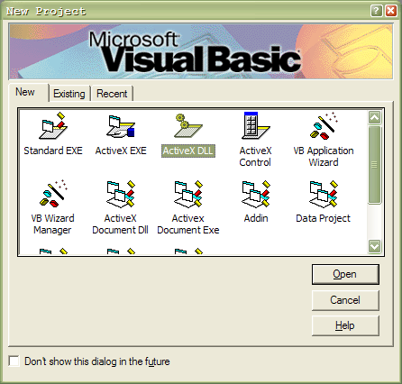
Creating a COM Class
Step 1
Open a new ActiveX DLL Project in Visual Basic 6

Slide 18
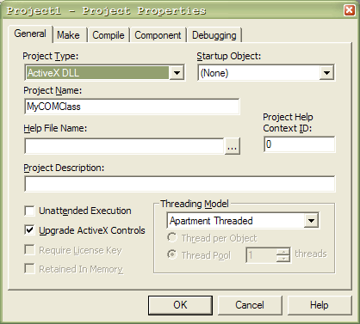
Creating a COM Class
Step 2
Rename the project

Slide 19
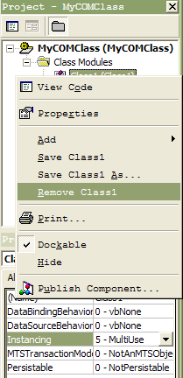
Creating a COM Class
Step 3
Remove the existing empty class

Slide 20
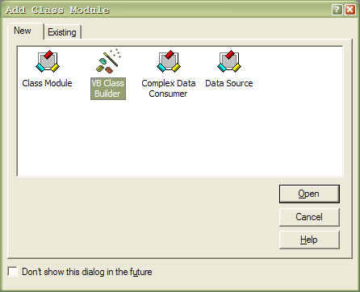
Creating a COM Class
Step 4
Open the VB Class builder

Slide 21
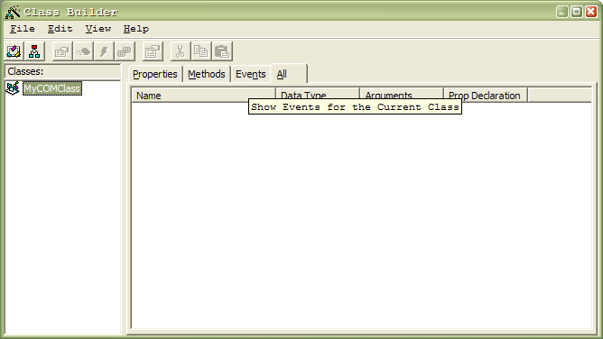
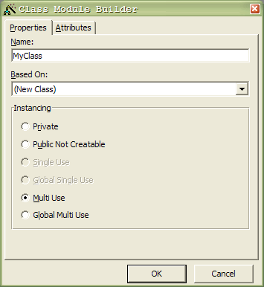
Creating a COM Class
Step 5
Create a new class

Slide 22
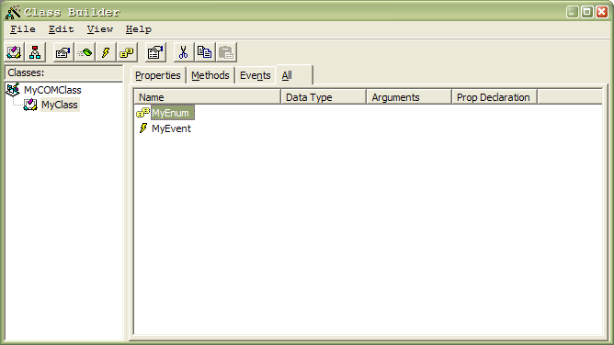
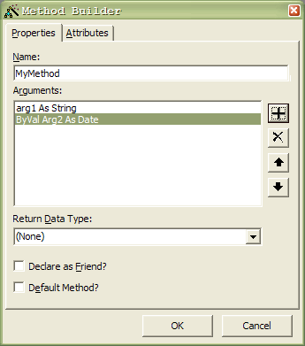
Creating a COM Class
Step 6
Add properties, methods, events and enums using the class builder.

Slide 23
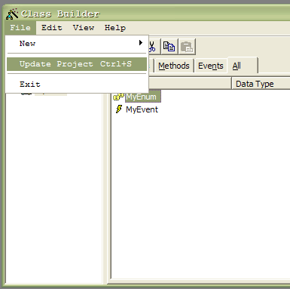
Creating a COM Class
Step 7
Update the project

Slide 24
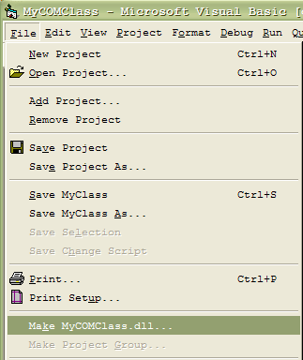
Save the project and compile the dll.

Slide 25
Make sure to visit us
Tutorials
Articles
Proikects
And much more
www.AdvancedQTP.com

